Slide 1
Dual-Battery System for High-Performance Driving
Project for Energy storage devices and systems
Kaustav Biswas
ed24m514

Slide 2
Project goals & motivation
To perform a “System-Level” Simulation for a High-performance driving scenario
To set up an experimental digital twin system of two batteries supplying a realistic load in an Electric vehicle
To study the impact of the “supporting” battery on the main battery’s electrical and thermal performance
To develop system level simulation expertise and develop a toolchain for further study

Slide 3
System architecture – broad description
A primary battery of “energy” type (cell chemistry with high energy density) for “base load” operation
A secondary battery of “power” type (cell chemistry with high power density) for “peak load” operation
Interface to the vehicle HV Bus: Direct connection for the primary battery; Connection via DC-DC Converter for the Secondary battery
Cell level electrical and Thermal model for each battery
Basic BMS for each battery to calculate SOC, Charge and Discharge Current Limits
A “Load current splitter” algorithm for distribution of load current between primary and secondary batteries
Realistic Load based on Vehicle Dynamics model and Road Load model
Torque Limitation based on current limits
Test scenarios and Drive Cycles

Slide 4
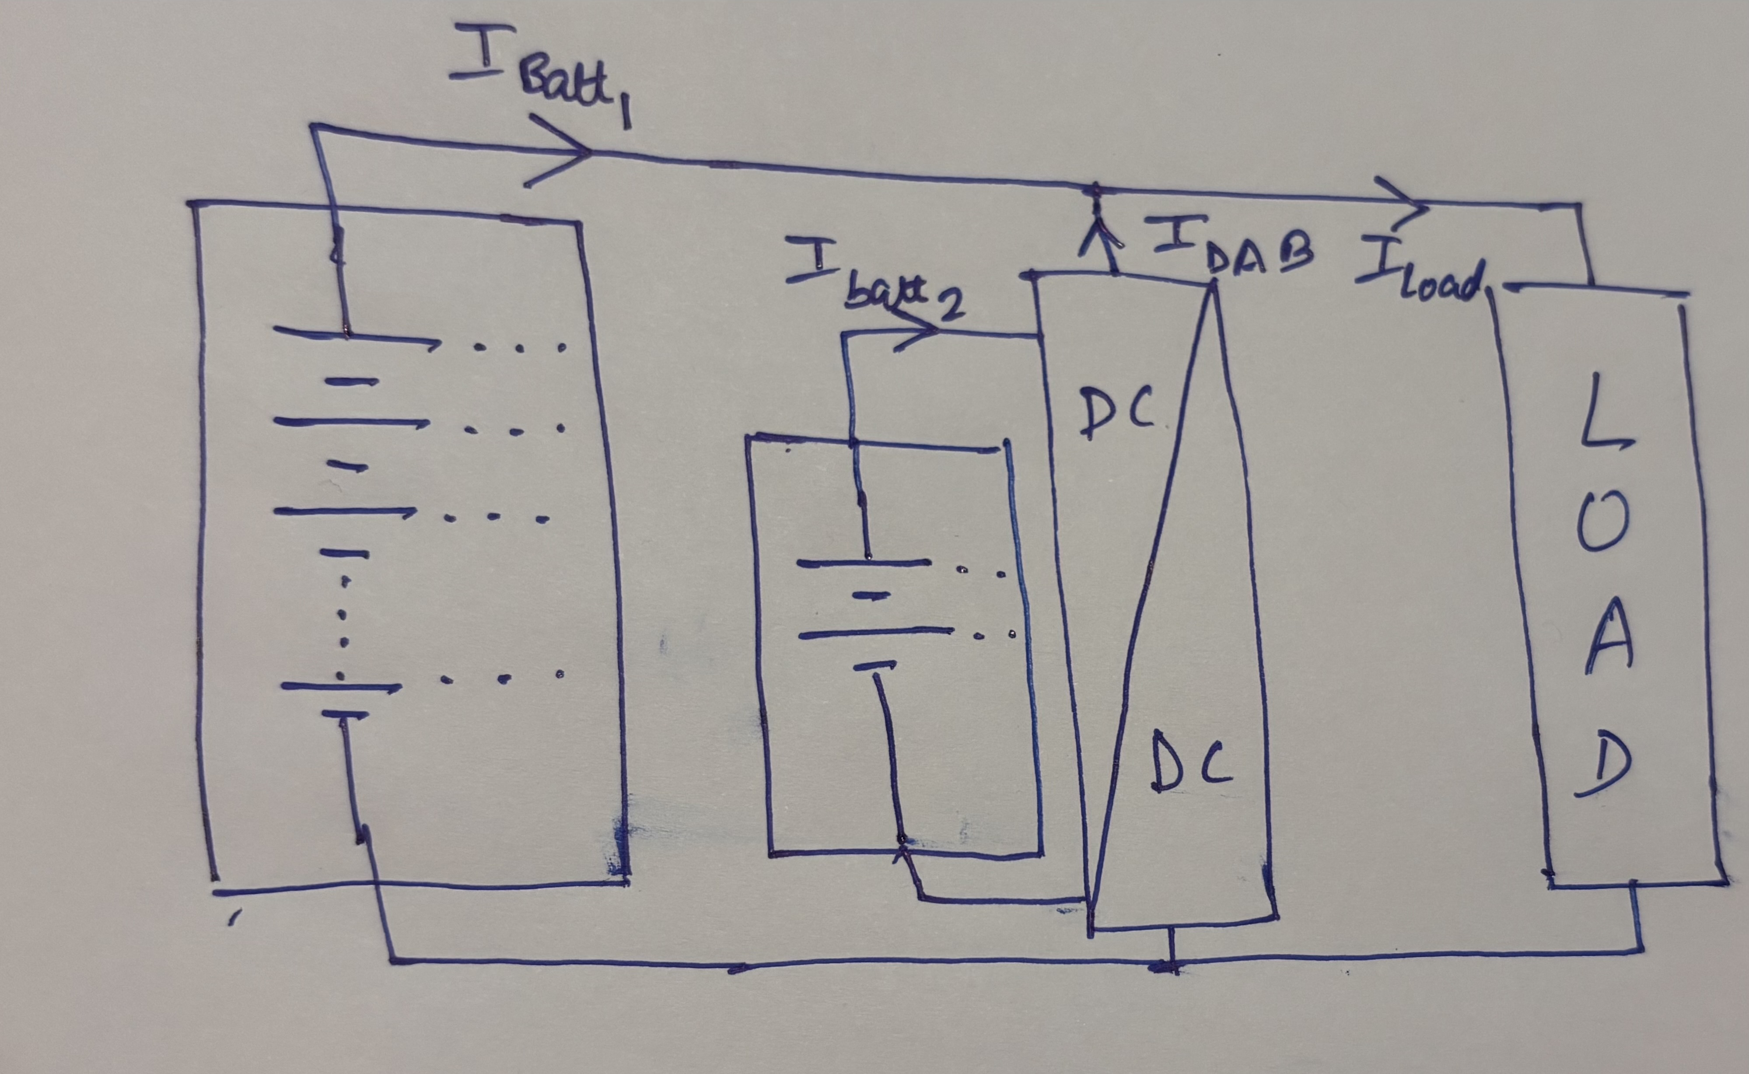
System architecture - diagram

Slide 5
Design choices for cells
Primary Battery pack’s cells: Based on NMC Chemistry
  No. of Cells: 660
  Configuration of battery pack: 3P220S
  Cell Nominal Voltage: 3.7 V
  Cell Nominal Capacity: 26Ah
  Cell Maximum C Rate and corresponding maximum current: 2.5 C & 65 A
  Pack Nominal Voltage: 770 V
  Pack Nominal Capacity: 60 kWh
  Pack Maximum C Rate and corresponding maximum current: 2.5 C & 160 A
Secondary Battery pack’s cells: Based on LTO Chemistry
  No. of Cells: 96
  Configuration of battery pack: 2P48S
  Cell Nominal Voltage: 2.4 V
  Cell Nominal Capacity: 23.5 Ah
  Cell Maximum C Rate and corresponding maximum current: 20 C (short time), 10 C & 235 A
  Pack Nominal Voltage: 115 V
  Pack Nominal Capacity: 5.08 kWh
  Pack Maximum C Rate and corresponding maximum current: 20 C (short time), 10 C & 470 A

Slide 6
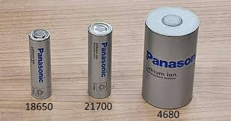

Cell SELECTION
Primary Battery pack’s cells: Based on NMC Chemistry – Tesla (Panasonic) 4680 Cylindrical Cell
  46 mm diameter and 80 mm height
Secondary Battery pack’s cells: Based on LTO Chemistry: Toshiba SCiB Prismatic Cell
  116 mm x 22 mm x 106 mm

Slide 7
CELL Modelling in SImulink
Electrical Model

Slide 8
Cell modelling in Simulink
Thermal model

Slide 9
Cell testing

Slide 10
Battery pack organization and bms modelling
Functions of each BMS
  Battery Pack SOC Calculation
  Battery Pack Voltage Calculation
  Battery Pack Temperature Calculation
  Battery Pack Discharge Current Limit Calculation
  Battery Pack Charge Current Limit Calculation

Slide 11
Battery pack organization and bms modelling
Battery Pack SOC Calculation

Slide 12
Battery pack organization and bms modelling
Battery Pack Discharge Current Limit Calculation

Slide 13
Battery pack organization and bms modelling
Battery Pack Charge Current Limit Calculation

Slide 14
DCDC Converter Selection for interfacing the secondary battery to the vehicle bus
Requirements:
  Sufficient power handling capacity based on the maximum targeted C rates for the secondary battery
  Bidirectional nature
  Isolated nature for interfacing of buses with different voltage levels
Selected topology:
  Dual Active Bridge Converter
Selected control methodology:
  High Voltage side Current control

Slide 15
Dual-Active Bridge Converter and control system

Slide 16
“load splitter” logic development
The primary objective is to maintain the NMC based primary battery’s health and thermal management by keeping its maximum C-rate low during charge and discharge under extreme scenarios
The secondary battery should be controlled in current-mode via the DAB converter such that a “support current” can be supplied (during discharge) or consumed (during charging)
The Load splitter logic takes an input based on the primary battery’s BMS commands of peak discharge and charge current limits and supplements the primary battery's current when the C rate climbs above 2 -2.5 C

Slide 17
“load splitter” logic development

Slide 18
Realistic load modelling & torque limitation
In order to perform realistic load simulation, a vehicle dynamics, speed controller as well as torque limiter model is prepared
Vehicle Speed is used as “driver’s intention” and a PID controller is tuned according to a road load and vehicle dynamics model
The speed controller outputs a Torque demand at the driveline level
The torque demand is then limited by:
  Peak torque capability of the powertrain
  System Charge and discharge current limits – Sum of the limits of the primary and secondary batteries as commanded by their respective BMS’s
The total mechanical power delivery is thus limited by electrical power capability
During braking, a “blending strategy” for electrical regeneration as well as mechanical friction braking is used and especially applicable when both batteries are at high SOC’s

Slide 19
Realistic load modelling

Slide 20
Torque limitation

Slide 21
Test setup
Abusive test cycle with peak acceleration and peak deceleration cycles for 400s
“Scaled up” WLTP cycle with heightened acceleration & deceleration demands
Test expectations:
  The secondary battery should be capable of supplying “supplementary currents” when the primary battery’s C rates climb higher than 2 -2.5 C
  The secondary battery should be capable of helping prevent thermal runaway of the primary battery
  Both batteries should be capable of maintaining their temperatures
  The acceleration and speed targets should be roughly achieved

Slide 22
Test results

